Slide 1
Ai & Data Science
Instructor: Jamal Nasir

Slide 2
Artificial Intelligence

Slide 3

What is Python?
Python is a popular high-level programming language used in various applications
Python is an easy language to learn because of its simple syntax
Python can be used for simple tasks such as plotting or for more complex tasks like machine learning

Slide 4
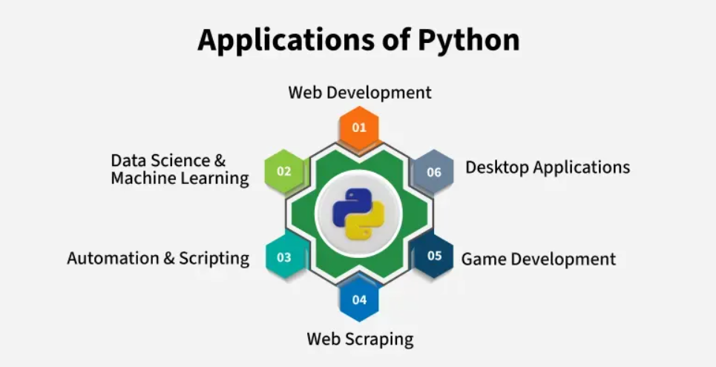
Why Python?

Slide 5
First Python Program
Here is a simple Python code, printing a string. We recommend that you edit the code and try to print your name.
# This is a comment. It will not be executed. print("Hello, World!")
Output: Hello, World!

Slide 6
How does this work:
print() is a built-in Python function that tells the computer to show something on the screen.
The message "Hello, World!" is a string, which means it's just text. In Python, strings are always written inside quotes (either single ' or double ").
Anything after # in a line is a comment. Python ignores comments when running the code, but they help people understand what the code is doing.
Comments are helpful for explaining code, making notes or skipping lines while testing.

Slide 7
Strings in python
A string in Python is a sequence of characters used to store and represent text data and must be enclosed with ‘ ‘,” “. first_name = “sam"
Last_name = ‘alex’
multiline = """This is
a multi-line
string."""

Slide 8
String Concatenation
To combine two strings: first_name = “Ali"
Last_name = “Ahmed"
result = first + " " + second
print(result)
Output: Ali Ahmed

Slide 9
String functions
name = “harry"
Print(len(name)
Print(name.ends with(“rry”)
Print(name.starts with(“har”)
Print(name.capitalize())

Slide 10
Comments in python:
Anything after # in a line is a comment. Python ignores comments when running the code, but they help people understand what the code is doing.
Comments are helpful for explaining code, making notes or skipping lines while testing.
# This is a comment. It will not be executed, it’s a single line comment.
""“
This is a multi-line comment.
It can be used to describe larger sections of code.
"""

Slide 11
Variables in python
In Python, variables serve as named storage locations for data values. They act as containers, holding information that can be accessed and modified throughout a program's execution.
name = "Alice" #string age = 30 # Integer variable height = 1.65 # Float is_student = False # Boolean variable

Slide 12
Variables in python
We can use the print() function to print single and multiple variables. We can print multiple variables by separating them with commas.
# Single variable
s = "Bob"
print(s)
# Multiple Variables
s = "Alice"
age = 25
city = "New York"
print(s, age, city)

Slide 13
Input from users in Python
name = input("Enter your name: ")
print("Hello,", name, "! Welcome!")

Slide 14
Multiple Inputs from users in Python
We are taking multiple input from the user in a single line, splitting the values entered by the user into separate variables for each value using the split() method. Then, it prints the values with corresponding labels, either two or three, based on the number of inputs provided by the user. # taking two inputs at a time
x, y = input("Enter two values: ").split()
print("Number of boys: ", x)
print("Number of girls: ", y)
# taking three inputs at a time
x, y, z = input("Enter three values: ").split()
print("Total number of students: ", x)
print("Number of boys is : ", y)
print("Number of girls is : ", z)

Slide 15
Conditions in Python
Conditions in Python are boolean expressions that evaluate to either True or False, and they are used to control the flow of execution in a program. They are primarily used in if, elif, and else statements to make decisions based on whether a condition is met.
Types of Conditions
Equals: (==): Checks if two values are equal.
Not equals: (!=): Checks if two values are not equal.
Greater than: (>): Checks if one value is greater than another.
Less than: (<): Checks if one value is less than another.
Greater than or equal to: (>=): Checks if one value is greater than or equal to another.
Less than or equal to: (<=): Checks if one value is less than or equal to another.

Slide 16
Conditional Statements:
Conditional Statements
if statement: Executes a block of code only if the condition is true.
elif statement: Checks multiple conditions in sequence and executes the corresponding block of code if the condition is true.
else statement: Executes a block of code if none of the preceding conditions are true
x = 10 y = 5 if x > y: print("x is greater than y") elif x < y: print("x is less than y") else: print("x is equal to y")

Slide 17
Conditional Statements:
# Prompting the user for input
age_input = input("Enter your age: ")
# Converting the input to an integer
age = int(age_input)
# Checking conditions based on user input
if age < 0:
print("Please enter a valid age.")
elif age < 18:
print("You are a minor.")
elif age >= 18 and age < 65:
print("You are an adult.")
else:
print("You are a senior citizen.")

Slide 18
Functions in Python :
Built in Functions print("Hello")
len([1, 2, 3])
sum([1, 2, 3])

Slide 19
Functions in Python:
def greet():
print("Hello!")
Positional Parameters def greet(name):
print(f"Hello, {name}!")
greet("Alice")

Slide 20
Functions in Python:
Default Parameters def greet(name="Guest"):
print(f"Hello, {name}!")
greet() # Hello, Guest
greet("Ali") # Hello, Ali

Slide 21
Functions in Python:
Keyword Arguments def student(name, age):
print(f"{name} is {age} years old.")
student(age=20, name="Ali")

Slide 22
Functions in Python:
Variable length Args def add(*numbers):
print(sum(numbers))
add(1, 2, 3, 4) # 10
def show_details(**info):
print(info)
show_details(name="Ali", age=20)
*args collects extra arguments into a tuple, **kwargs into a dictionary

Slide 23
Functions in Python:
Return Function def square(x):
return x * x
print(square(5)) # 25
#Returning multiple values def calc(a, b):
return a + b, a - b
add, sub = calc(5, 3)
print(add, sub) # 8 2

Slide 24
Functions in Python:
Lambda Function(anonymous one-line function) square = lambda x: x * x
print(square(4)) # 16

Slide 25


